Slide 1

Setting up Interactive Notebooks
Cover Page – Number and Algebra
Contents
Glossary
Rule up and number pages for 4 lessons
Today
Topic: Simple Interest
EQ: How do you calculate interest?

Slide 2
Interest
Suppose you want to buy a car, or a house, or something else but you don’t have the ready cash to pay for it. Then you may have to BORROW the money from a bank. If you do this, then the bank charges an extra fee for the privilege of borrowing money from them.
This is called INTEREST.
If you’re in the fortunate position of having money to INVEST (the opposite of borrowing), then the bank will pay you interest!

Slide 3
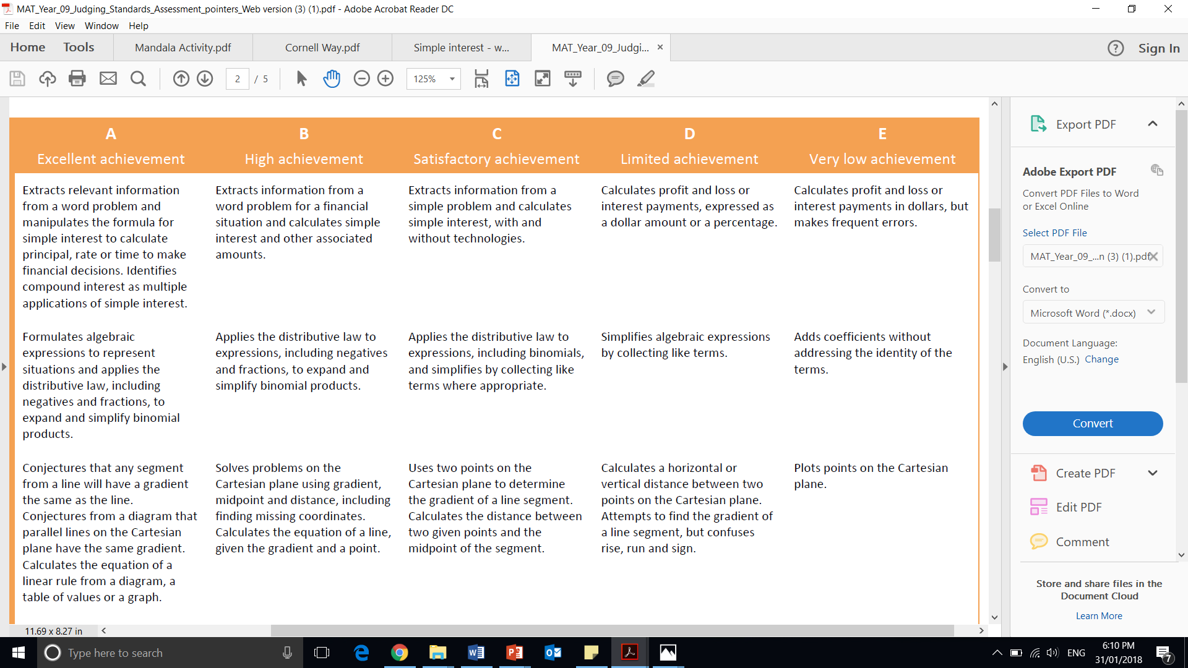
Judging Standards

Slide 4
Topic: Simple Interest
EQ: How do you calculate interest?
Principal: The amount you either borrow or invest
Rate: The percentage rate per annum (pa means per year)
Time: The number of years you borrow or invest the principal.
Key terms and equation
If I borrow $P for T years and the interest is R% per annum.
Then the amount of interest I pay is equal to
I = PRT
The Rate needs to be converted from a PERCENTAGE to a DECIMAL

Slide 5
Topic: Simple Interest?
Add key words to your glossary!!!!!
EQ: How do you calculate interest?
Then the amount of interest I pay is equal to
I = PRT
Convert between percentage to decimal
The Rate needs to be converted from a PERCENTAGE to a DECIMAL
Divide by 100 (or move decimal point twice to the left)
Per annum
p/a means each year
Investment
Earning money
Loan
Borrowing money from the bank and paying more money back

Slide 6


Slide 7

You don’t need to write this just follow along
How it works……….
Suppose I borrow $2000 (called the Principal, or “P”) and the interest is 15% per annum.
for one year (T = 1)
15% as a decimal = 0.15
Then the amount of interest I pay is equal to $2000 ×0.15 ×1$
= $300.
IF I paid off the loan in 1 year (T=1) the total I would have to give back to the bank would be $2,300 (principal amount + simple interest)
What if I broke my hip and had to stop working for awhile so I couldn’t earn enough to pay it back in 1 year and instead it took me 5 years?
Everything else stays the same except T = 5
$2000 ×0.15 ×5$= $1,500
Total to pay back to the bank: $3,500

Slide 8


Lets Try it out!
P = $1,000
T=2
R = 20% convert to decimal →
Calculate simple interest
Now you try with a partner :
P = $1,500
T = 3
R= 15%
0.2
I = PRT
$$I=1000×0.2×2$$
$$I=400$$
Simple interest earned is $400

